Slide 1
AWS – Module 3

Slide 2
Table of Contents
Elastic Compute Cloud – EC2
Elastic Block Storage - EBS

Slide 3
Amazon EC2
Amazon Elastic Compute Cloud (Amazon EC2) provides scalable computing capacity in the Amazon Web Services (AWS) cloud. Using Amazon EC2 eliminates your need to invest in hardware up front, so you can develop and deploy applications faster.
Features of Amazon EC2
Virtual computing environments, known as instances
Preconfigured templates for your instances, known as Amazon Machine Images (AMIs), that package the bits you need for your server (including the operating system and additional software)
Various configurations of CPU, memory, storage, and networking capacity for your instances, known as instance types
Secure login information for your instances using key pairs (AWS stores the public key, and you store the private key in a secure place)

Slide 4
Amazon EC2 – Instance Types
When you launch an instance, the instance type that you specify determines the hardware of the host computer used for your instance.
Each instance type offers different compute, memory, and storage capabilities and are grouped in instance families based on these capabilities
Amazon EC2 provides each instance with a consistent and predictable amount of CPU capacity, regardless of its underlying hardware.
Instance Family | Current Generation Instance Types
General purpose | t2.nano | t2.micro | t2.small | t2.medium | t2.large | t2.xlarge | t2.2xlarge | m4.large | m4.xlarge | m4.2xlarge | m4.4xlarge | m4.10xlarge | m4.16xlarge | m3.medium | m3.large | m3.xlarge | m3.2xlarge
Compute optimized | c4.large | c4.xlarge | c4.2xlarge | c4.4xlarge | c4.8xlarge | c3.large | c3.xlarge | c3.2xlarge | c3.4xlarge | c3.8xlarge
Memory optimized | r3.large | r3.xlarge | r3.2xlarge | r3.4xlarge | r3.8xlarge | r4.large | r4.xlarge | r4.2xlarge | r4.4xlarge | r4.8xlarge | r4.16xlarge | x1.16xlarge | x1.32xlarge
Storage optimized | d2.xlarge | d2.2xlarge | d2.4xlarge | d2.8xlarge | i2.xlarge | i2.2xlarge | i2.4xlarge | i2.8xlarge | i3.large | i3.xlarge | i3.2xlarge | i3.4xlarge | i3.8xlarge | i3.16xlarge
Accelerated computing | f1.2xlarge | f1.16xlarge | p2.xlarge | p2.8xlarge | p2.16xlarge | g2.2xlarge | g2.8xlarge | g3.4xlarge | g3.8xlarge | g3.16xlarge
There is a limit on the total number of instances that you can launch in a region, and there are additional limits on some instance types.

Slide 5
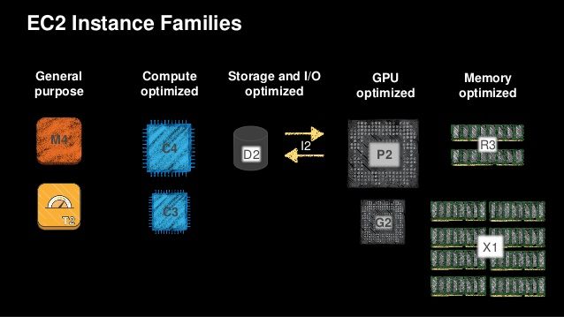
Amazon EC2 – Instance Types
There is a limit on the total number of instances that you can launch in a region, and there are additional limits on some instance types.

Slide 6
Amazon EC2 – Instance Types
On-Demand instances — Pay, by the hour, for the instances that you launch.
Reserved Instances — Purchase, at a significant discount, instances that are always available, for a term from one to three years
Scheduled Instances — Purchase instances that are always available on the specified recurring schedule, for a one-year term.
Spot instances — Bid on unused instances, which can run as long as they are available and your bid is above the Spot price, at a significant discount.
Dedicated hosts — Pay for a physical host that is fully dedicated to running your instances, and bring your existing per-socket, per-core, or per-VM software licenses to reduce costs.
Dedicated instances — Pay, by the hour, for instances that run on single-tenant hardware

Slide 7
Amazon EC2 – Root Device Volume
When you launch an instance, the root device volume contains the image used to boot the instance. When we introduced Amazon EC2, all AMIs were backed by Amazon EC2 instance store, which means the root device for an instance launched from the AMI is an instance store volume created from a template stored in Amazon S3
You can choose between AMIs backed by Amazon EC2 instance store and AMIs backed by Amazon EBS. We recommend that you use AMIs backed by Amazon EBS, because they launch faster and use persistent storage.
You can launch an instance from either an instance store-backed AMI or an Amazon EBS-backed AMI. The description of an AMI includes which type of AMI it is; you'll see the root device referred to in some places as either ebs (for Amazon EBS-backed) or instance store (for instance store-backed).

Slide 8
Amazon EC2 – AMI
The Amazon Machine Image (AMI) defines the initial software that will be on an instance when it is launched. An AMI defines every aspect of the software state at instance launch, including:
The Operating System (OS) and its configuration
The initial state of any patches
Application or system software
All AMIs are based on x86 OSs, either Linux or Windows.
There are Four Sources of AMI’s
Published by AWS - AMIs with versions of many different OSs, both Linux and Windows.
The AWS Marketplace - is an online store that helps customers find, buy, and immediately start using the software and services that run on Amazon EC2
Generated from existing Instances - An AMI can be created from an existing Amazon EC2 instance.
Up-loaded Virtual Servers - Using AWS VM Import/Export service, customers can create images from various virtualization formats

Slide 9
Amazon Security Group
A security group acts as a virtual firewall that controls the traffic for one or more instances. When you launch an instance, you associate one or more security groups with the instance.
You add rules to each security group that allow traffic to or from its associated instances. You can modify the rules for a security group at any time; the new rules are automatically applied to all instances that are associated with the security group.
Security Group Rules
By default, security groups allow all outbound traffic.
Security group rules are always permissive; you can't create rules that deny access.
Security groups are stateful — if you send a request from your instance, the response traffic for that request is allowed to flow in regardless of inbound security group rules.
You can add and remove rules at any time. Your changes are automatically applied to the instances associated with the security group after a short period.

Slide 10
Elastic IP Address Basics
The following are the basic characteristics of an Elastic IP address:
To use an Elastic IP address, you first allocate one to your account, and then associate it with your instance or a network interface.
When you associate an Elastic IP address with an instance or its primary network interface, the instance's public IPv4 address (if it had one) is released back into Amazon's pool of public IPv4 addresses. You cannot reuse a public IPv4 address.
You can disassociate an Elastic IP address from a resource, and reassociate it with a different resource.
A disassociated Elastic IP address remains allocated to your account until you explicitly release it.
To ensure efficient use of Elastic IP addresses, we impose a small hourly charge if an Elastic IP address is not associated with a running instance, or if it is associated with a stopped instance or an unattached network interface.
An Elastic IP address is for use in a specific region only.
When you associate an Elastic IP address with an instance that previously had a public IPv4 address, the public DNS hostname of the instance changes to match the Elastic IP address.
We resolve a public DNS hostname to the public IPv4 address or the Elastic IP address of the instance outside the network of the instance, and to the private IPv4 address of the instance from within the network of the instance.

Slide 11
Amazon Elastic Block Store (EBS)
Amazon Elastic Block Store (Amazon EBS) provides block level storage volumes for use with EC2 instances
EBS volumes are highly available and reliable storage volumes that can be attached to any running instance that is in the same Availability Zone. 99.999% Availability
EBS volumes that are attached to an EC2 instance are exposed as storage volumes that persist independently from the life of the instance
EBS volumes are particularly well-suited for use as the primary storage for file systems, databases, or for any applications that require fine granular updates and access to raw, unformatted, block-level storage
Amazon EBS is recommended when data must be quickly accessible and requires long-term persistence
Amazon EBS is well suited to both database-style applications that rely on random reads and writes, and to throughput-intensive applications that perform long, continuous reads and writes.

Slide 12
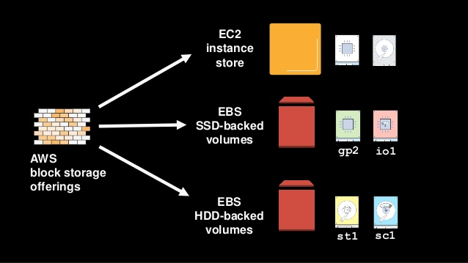
Amazon Elastic Block Store (EBS) - Offerings

Slide 13
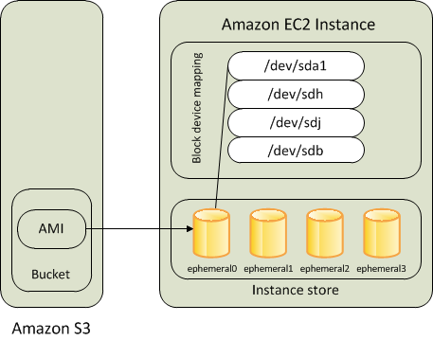
Amazon EC2 – Instance Store Volume
Instances that use instance stores for the root device automatically have one or more instance store volumes available, with one volume serving as the root device volume. When an instance is launched, the image that is used to boot the instance is copied to the root volume.
Any data on the instance store volumes persists as long as the instance is running, but this data is deleted when the instance is terminated (instance store-backed instances do not support the Stop action) or if it fails (such as if an underlying drive has issues).

Slide 14
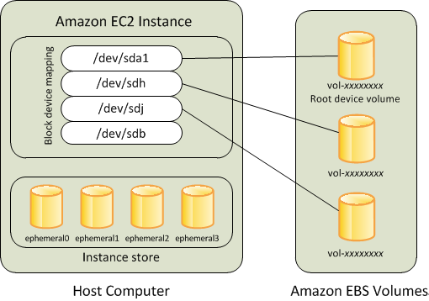
Amazon EC2 – EBS Store Volume
Instances that use Amazon EBS for the root device automatically have an Amazon EBS volume attached. When you launch an Amazon EBS-backed instance, we create an Amazon EBS volume for each Amazon EBS snapshot referenced by the AMI you use.
An Amazon EBS-backed instance can be stopped and later restarted without affecting data stored in the attached volumes. There are various instance– and volume-related tasks you can do when an Amazon EBS-backed instance is in a stopped state. For example, you can modify the properties of the instance, you can change the size of your instance or update the kernel it is using, or you can attach your root volume to a different running instance for debugging or any other purpose.

Slide 15
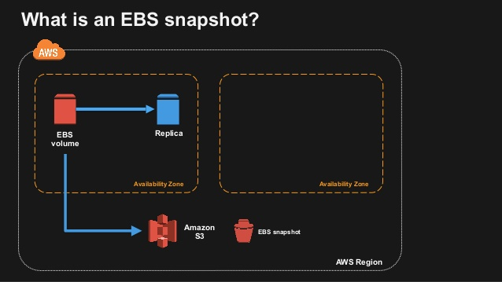
Amazon EBS Snapshot

Slide 16
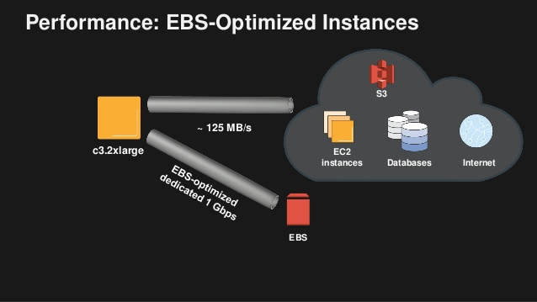
Amazon EBS Optimzed Instance

Slide 17
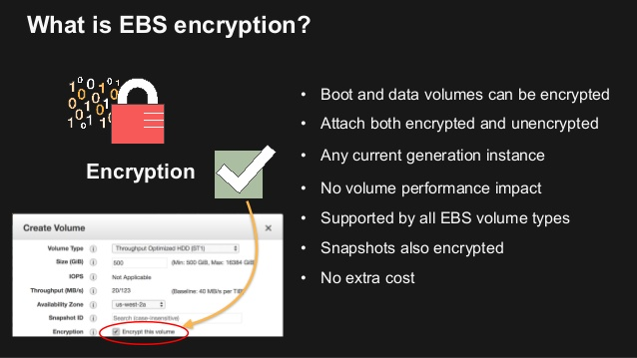
Amazon EBS Encryption

Slide 18
EBS Store Volume vs Instance Store Volume
Instance Store Volume
Physically attached to the Host
Type and amount differs by instance type
Data Dependent on the lifecycle of the instance
EBS Volume
Persistent Block level Storage Volume
Magnetic thoughput (st1) & Magnetic Cold (sc1)
General Purpose SSD and Provisioned IOPS SSD
Data Independent of Instance lifecycle
Key Points to Remember
EBS volumes automatically gets replicated within the availability zone in which they are created
Use EBS-optimized instances to deliver dedicated through-put between EC2 and EBS, with options between 500 and 10,000 Mbps, depending on the instance type
EBS Snapshot is a point in time backup copy of an EBS volume that is stored in S3
Snapshots are Incremental, only the blocks that have changed after your most recent snapshots are saved

Slide 19
Few Definitions Needs to Remember
IOPS – Input/Output operations per second (#)
Throughput – Read/Write rate to storage (Mb/s)
Latency – Delay between request and completion (ms)
Capacity – Volume of data that can be stored (GB)
Block size – Size of each I/O (KB)

Slide 20
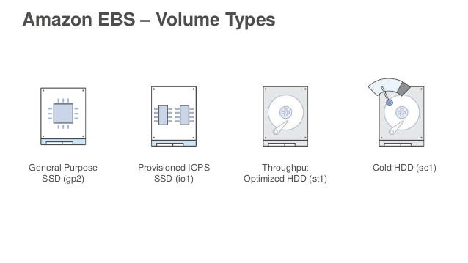
Volume Management and Types
Volume management, use Tags
Delete on termination flags, can be changed anytime
It is persistent storage, it will stay around
Should have an approach, example tag volume

Slide 21
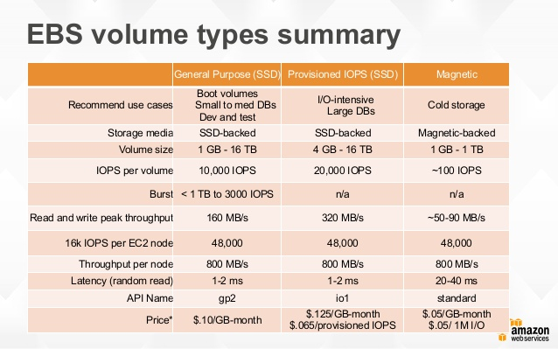
EBS Volume Comparison Chart

